Slide 1

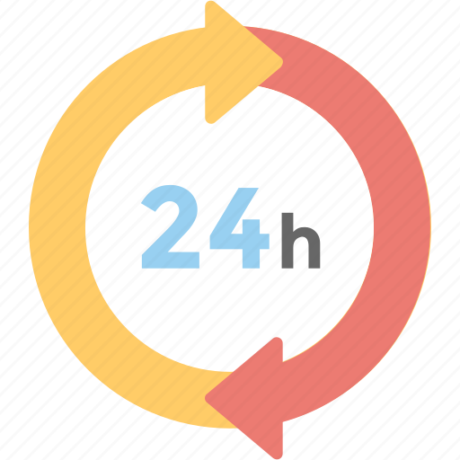
24-HOUR FORECAST
21-10-2022 @ 1200 UTC
Department of Meteorology and Climate Science,
KNUST.

Slide 2
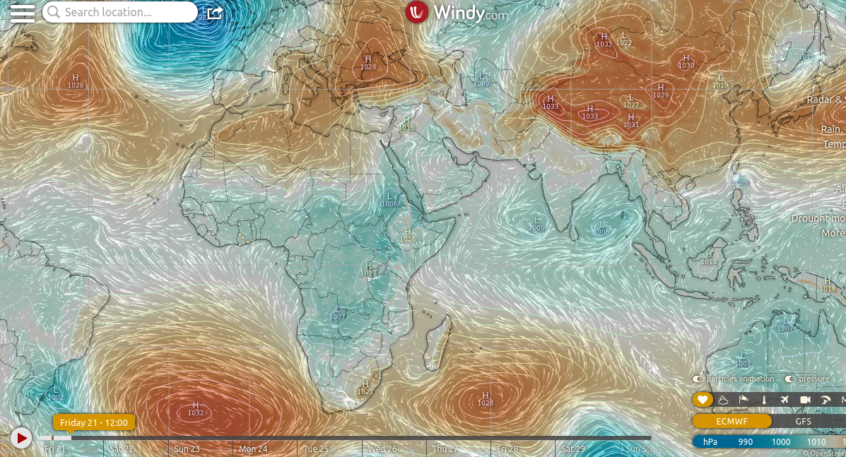
Presure System @ 1200 UTC
1028 hPa
1032 hPa

Slide 3
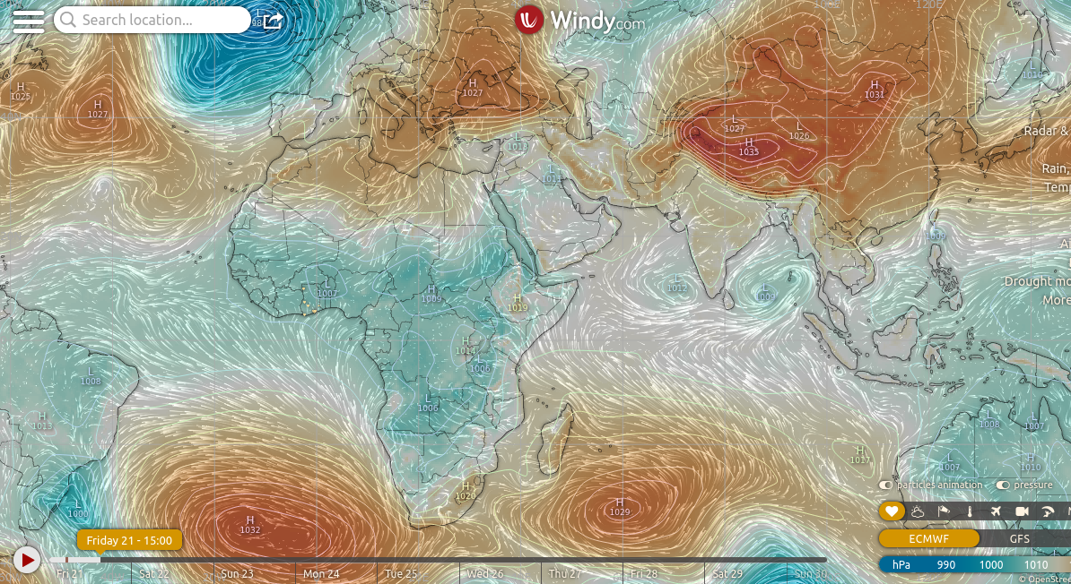
Presure System @ 1500 UTC
1027 hPa
1032 hPa

Slide 4
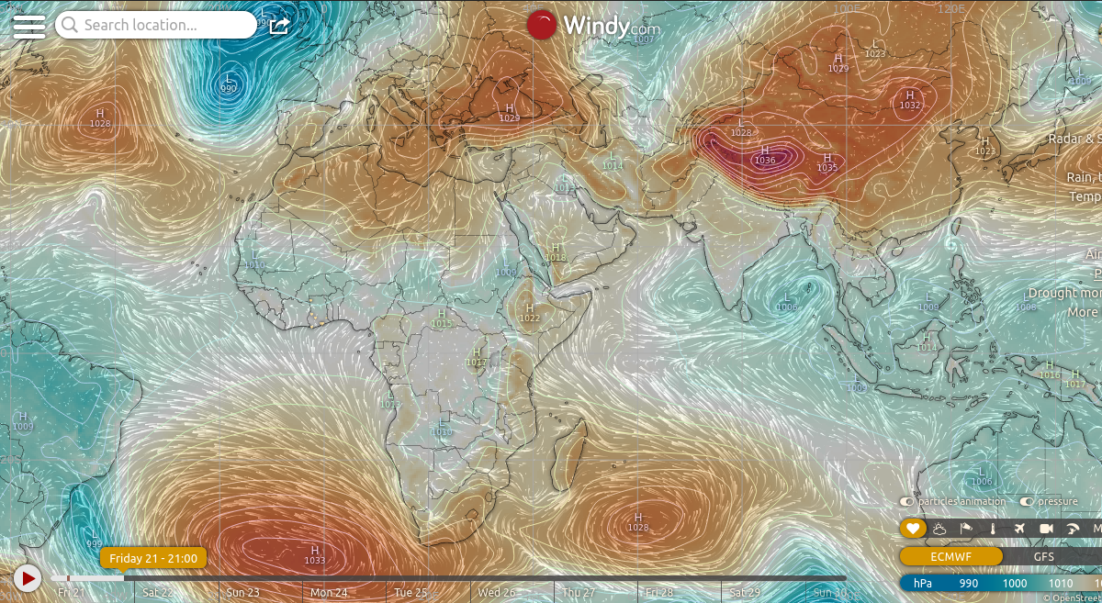
Presure System @ 1800 UTC
1027 hPa
1033 hPa

Slide 5
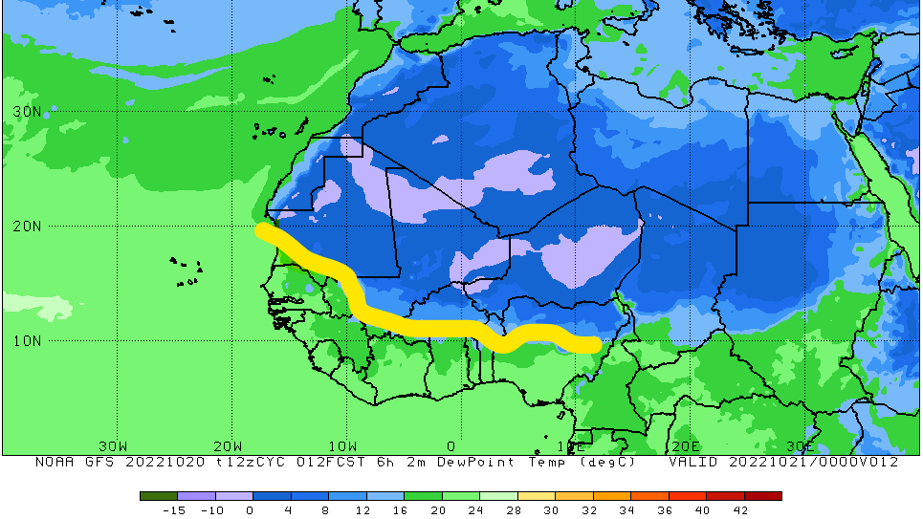
ITD Position at 1200 UTC
10.8 N

Slide 6
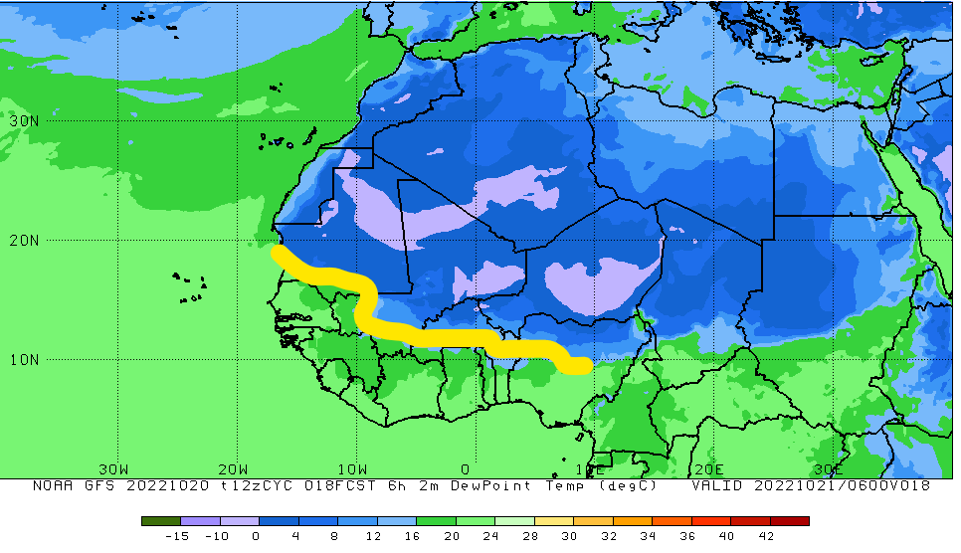
ITD Position at 1800 UTC
10.9 N

Slide 7
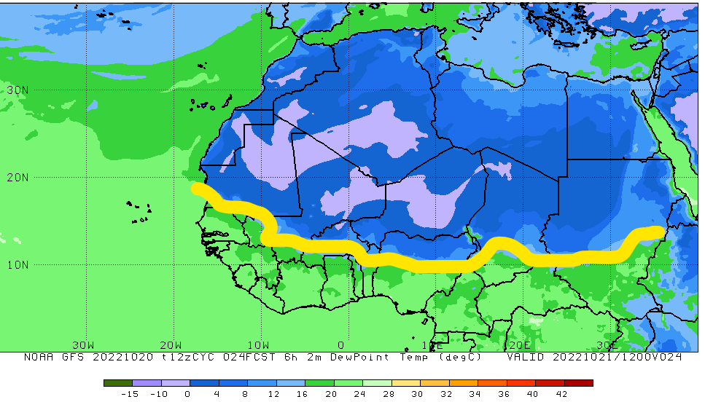
ITD Position at 0000 UTC
11.0 N

Slide 8
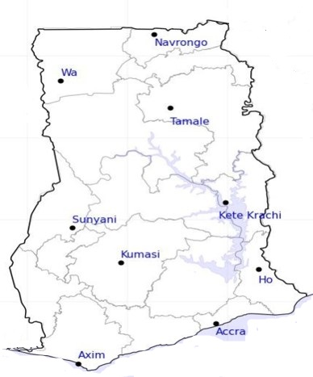

24-HOUR FORECAST
21-10-2022 @ 1200 UTC
59
58
RH AT DAY
[%]
71
62
75
66
78
78
82
70

Slide 9
67
24-HOUR FORECAST
21-10-2022 @ 1200 UTC
63
RH AT NIGHT
[%]
78
78
82
94
95
96
88
86

Slide 10
122
24-HOUR FORECAST
21-10-2022 @ 1200 UTC
123
CAPE AT DAY
672
104
1116
446
J/kg
619
490
430
178

Slide 11
23
24-HOUR FORECAST
21-10-2022 @ 1200 UTC
65
CAPE AT NIGHT
416
190
1821
328
J/kg
469
311
288
130

Slide 12
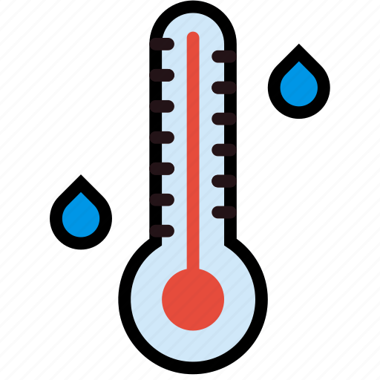
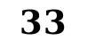
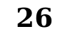
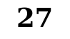
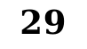
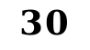
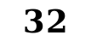

$$33$$
24-HOUR FORECAST
21-10-2022 @ 1200 UTC
$$32$$
TEMPERATURE AT DAY [$℃$]
28
28
30
$$30$$
$$27$$
$$29$$
$$27$$
$$26$$

Slide 13
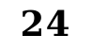
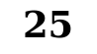
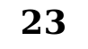
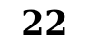
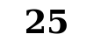

$$25$$
24-HOUR FORECAST
21-10-2022 @ 1200 UTC
$$25$$
TEMPERATURE AT NIGHT [$$℃$$]
$$22$$
$$22$$
$$26$$
23
$$24$$
$$23$$
$$26$$
$$25$$

Slide 14



GENERAL OUTLOOK
24-HOUR FORECAST
21-10-2022 @ 1200 UTC
Rain
Wind
Dust
PROBABILITY OF RAINS
30 %
Low risk
Be aware
Be Prepared
Take Action

Slide 15
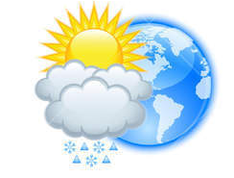




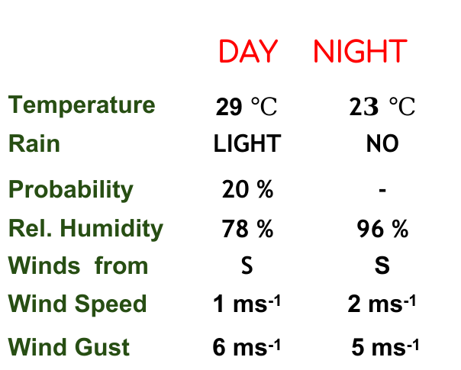
Meteorology and Climate Science
Department of Meteorology and Climate Science , KNUST
24-HOUR FORECAST
21-10-2022 @ 1200 UTC
Rain
Wind
Dust
Forecast Summary (KUMASI)
 | DAY | NIGHT
Temperature | 29 $℃$ | 2$3 ℃$
Rain | LIGHT | NO
Probability | 20 % | -
Rel. Humidity | 78 % | 96 %
Winds from | S | S
Wind Speed | 1 ms⁻¹ | 2 ms⁻¹
Wind Gust | 6 ms⁻¹ | 5 ms⁻¹
Low risk
Be aware
Be Prepared
Take Action
SUNSET: 05:53 PM SUNRISE: 05:50 AM

Slide 16


